Slide 1
A Simple Computer Architecture

Slide 2
Instruction Set Architecture (ISA) for Simple Computer (SC)
A programmable system uses a sequence of instructions to control its operation
An typical instruction specifies:
Operation to be performed
Operands to use, and
Where to place the result, or
Which instruction to execute next
Instructions are stored in RAM or ROM as a program
The addresses for instructions in a computer are provided by a program counter (PC) that can
Count up
Load a new address based on an instruction and, optionally, status information

Slide 3
Instruction Set Architecture (ISA)
The PC and associated control logic are part of the Control Unit
Executing an instruction - activating the necessary sequence of operations specified by the instruction
Execution is controlled by the control unit and performed:
In the datapath
In the control unit
In external hardware such as memory or input/output

Slide 4
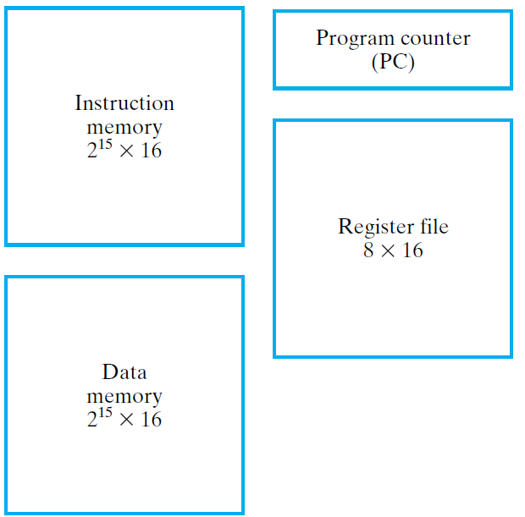
ISA: Storage Resources
The storage resources are "visible" to the programmer at the lowest software level (typically, machine or assembly language)
Separate instruction and data memories imply "Harvard architecture"

Slide 5
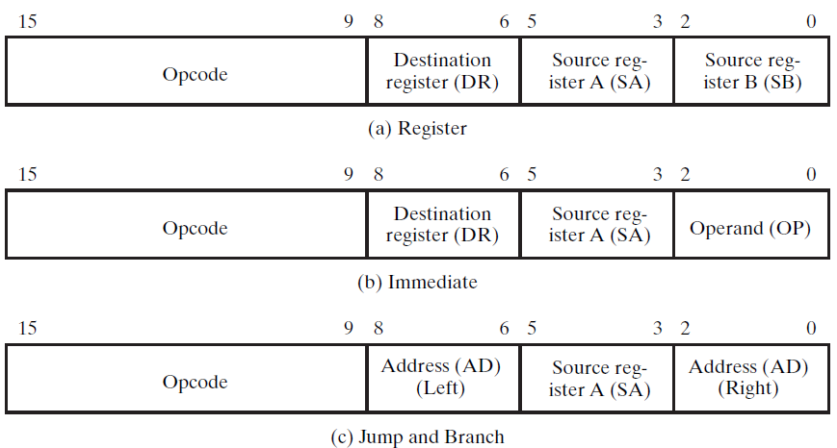
ISA: Instruction Format
A instruction consists of a bit vector
The fields of an instruction are subvectors representing specific functions and having specific binary codes defined
The format of an instruction defines the subvectors and their function
R1 ← R2 + R3
R1 ← sl R2
R1 ← R2 + 3
Change the sequence of instruction execution by adding an extended, 6-bit, signed 2s-complement address offset to the PC value

Slide 6
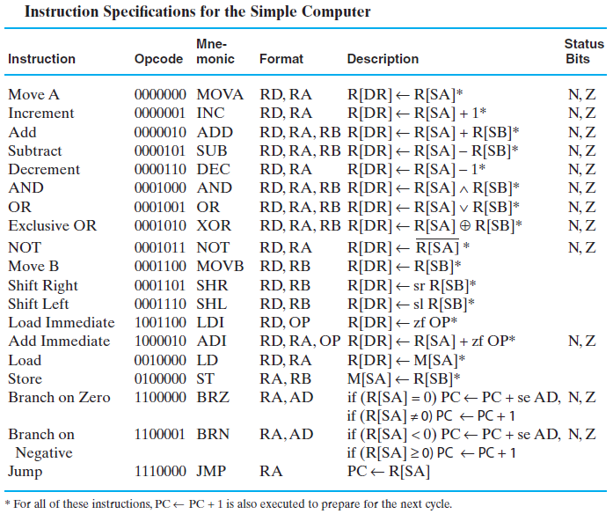
ISA: Instruction Specifications

Slide 7
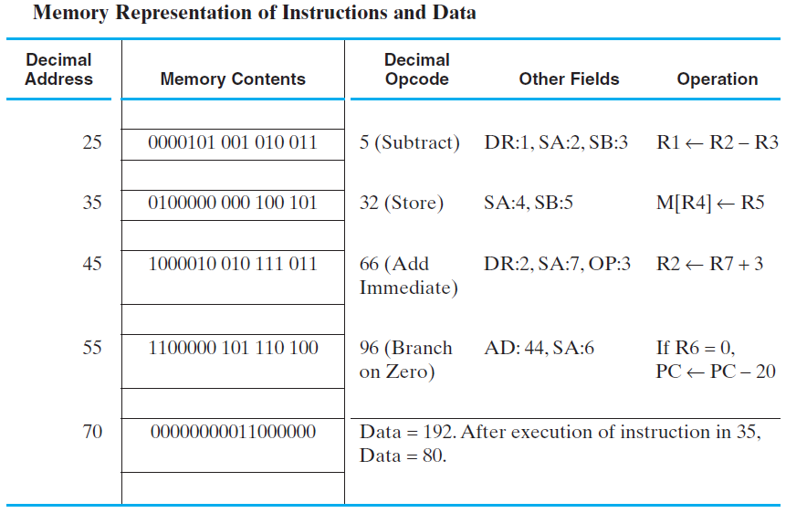
ISA:Example Instructions and Data in Memory

Slide 8
Single-Cycle Hardwired Control
PL – load enable for the PC
JB – Jump/Branch select:
If JB = 1, Jump, else Branch
BC – Branch Condition select: If BC = 1, branch for N = 1, else branch for Z = 1.
Based on the ISA defined, design a computer architecture to support the ISA
The architecture is to fetch and execute each instruction in a single clock cycle

Slide 9
Instruction Decoder
The combinational instruction decoder converts the instruction into the signals necessary to control all parts of the computer during the single cycle execution
The input is the 16-bit Instruction
The outputs are control signals:
Register file addresses DA, AA, and BA,
Function Unit Select FS
Multiplexer Select Controls MB and MD,
Register file and Data Memory Write Controls RW and MW, and
PC Controls PL, JB, and BC
The register file outputs are simply pass-through signals: DA = DR, AA = SA, and BA = SB .

Slide 10
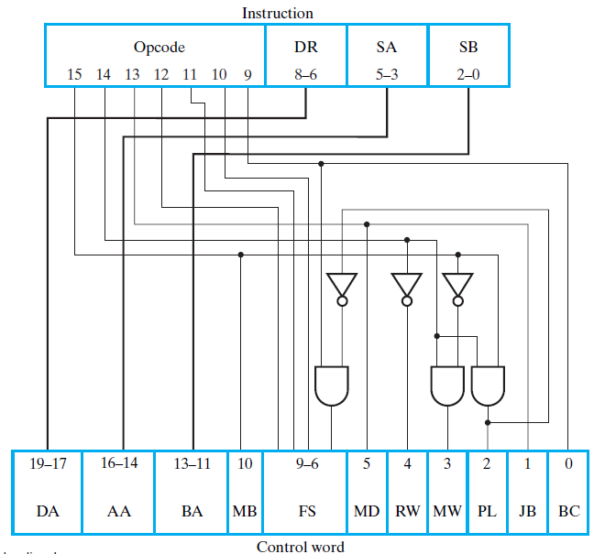
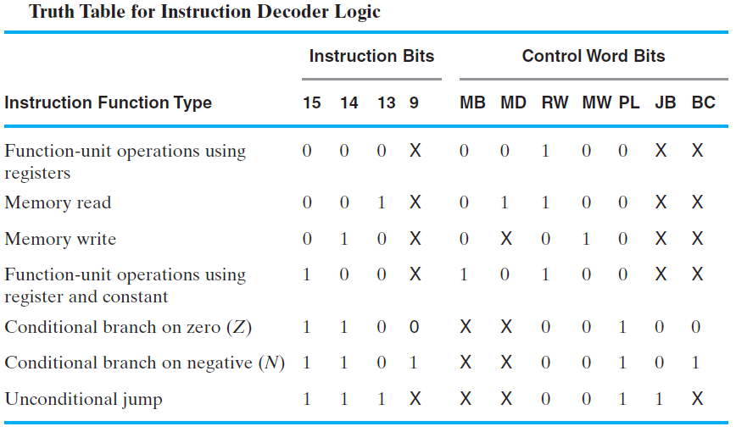

Slide 11
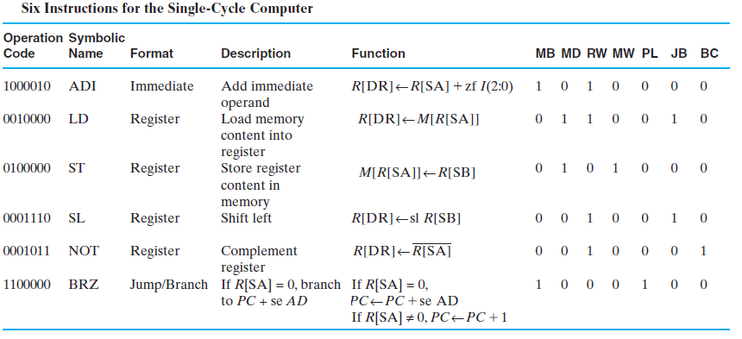
Example Instruction Execution

Slide 12
Decoding for ADI
1 0 0 0 0 1 0
Instruction
Opcode
DR
SA
SB
15
14
13
12
11
10
9
8
–
6
5
–
3
2
–
0
16
19
–
14
–
17
13
–
11
10
9
–
6
5
4
3
2
1
0
1
0 0 1 0
0
1
0
0
0
0
DA
AA
BA
MB
FS
MD
RW
MW
PL
JB
BC
Control word

Slide 13
Extend
IR(8:6) || IR(2:0)
V
C
Branch
PC
Control Inputs and Paths for ADI
N
Control
Z
P
J
B
Address
L
B
C
Instruction
1
0
0
0
memory
RW
D
Instruction
DA
Register
Increment PC
AA
A
file
B
BA
IR(2:0)
Zero fill
Constant
Instruction decoder
in
1
0
MB
1
MUX B
Address out
Bus A
Bus B
0
No Write
Data out
MW
D
B
A
M
F
M
R
M
P
J
B
0 0 1 0
A
A
A
B
S
D
W
W
L
B
C
A
+
B
Data in
Address
1
0
1
0
0
0
0
FS
0 0 1 0
CONTROL
V
Function
Data
C
unit
memory
N
Data out
Z
F
Data in
0
MD
0
1
Bus D
MUX D
DATAPATH

Slide 14
Decoding for LD
0 0 1 0 0 0 0
Instruction
Opcode
DR
SA
SB
15
14
13
12
11
10
9
8
–
6
5
–
3
2
–
0
16
19
–
14
–
17
13
–
11
10
9
–
6
5
4
3
2
1
0
0
0 0 0 0
1
1
0
0
1
0
DA
AA
BA
MB
FS
MD
RW
MW
PL
JB
BC
Control word

Slide 15
Extend
IR(8:6) || IR(2:0)
V
C
Branch
PC
Control Inputs and Paths for LD
N
Control
Z
P
J
B
Address
L
B
C
Instruction
1
0
1
0
memory
RW
D
Instruction
DA
Register
Increment PC
AA
A
file
B
BA
IR(2:0)
Zero fill
Constant
Instruction decoder
in
1
0
MB
0
MUX B
Address out
Bus A
Bus B
0
No Write
Data out
MW
D
B
A
M
F
M
R
M
P
J
B
0 0 0 0
A
A
A
B
S
D
W
W
L
B
C
A
B
Data in
Address
0
1
1
0
0
1
0
FS
0 0 0 0
CONTROL
V
Function
Data
C
unit
memory
N
Data out
Z
F
Data in
1
MD
0
1
Bus D
MUX D
DATAPATH

Slide 16
Decoding for BRZ
1 1 0 0 0 0 0
Instruction
Opcode
DR
SA
SB
15
14
13
12
11
10
9
8
–
6
5
–
3
2
–
0
16
19
–
14
–
17
13
–
11
10
9
–
6
5
4
3
2
1
0
1
0 0 0 0
0
0
0
1
0
0
DA
AA
BA
MB
FS
MD
RW
MW
PL
JB
BC
Control word

Slide 17
Extend
IR(8:6) || IR(2:0)
V
C
Branch
PC
Control Inputs and Paths for BRZ
N
Control
Z
No Write
P
J
B
Address
L
B
C
Instruction
0
1
0
0
memory
RW
D
Instruction
DA
Register
Branch on
Z
AA
A
file
B
BA
IR(2:0)
Zero fill
Constant
Instruction decoder
in
1
0
MB
1
MUX B
Address out
Bus A
Bus B
0
No Write
Data out
MW
D
B
A
M
F
M
R
M
P
J
B
0 0 0 0
A
A
A
B
S
D
W
W
L
B
C
A
B
Data in
Address
1
0
0
0
1
0
0
FS
0 0 0 0
CONTROL
V
Function
Data
C
unit
memory
N
Data out
Z
F
Data in
0
MD
0
1
Bus D
MUX D
DATAPATH

Slide 18
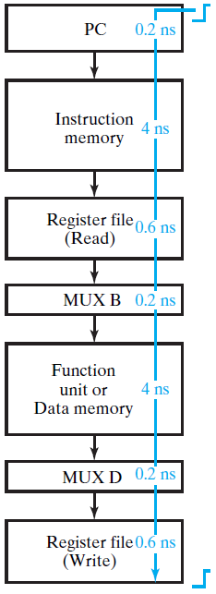
Single-Cycle Computer Issues
Shortcoming of Single Cycle Design
Complexity of instructions executable in a single cycle is limited
Accessing both an instruction and data from a simple single memory impossible
A long worst case delay path limits clock frequency and the rate of performing instructions

